Slide 1
DIGITAL SIGNAL PROCESSING(DSP)
COURSE OUTLINES:
BASIC ELEMENTS OF DSP
Z TRANSFORM (ZT)
DISCRETE FOURIER TRANSFORMS (DFT)
FAST FOURIER TRANSFORMS (FFT)
IIR (Infinite Impulse Response) FILTER DESIGN
FIR(Finite Impulse Response) FILTER DESIGN
FINITE WORD LENGTH EFFECTS
DIGITAL SIGNAL PROCESSORS
Dr Ngenzi Alexander

Slide 2
Basic elements of Digital Signal Processing:
DSP definition
Revision on signals and systems
Limitations of Analog Signal Processing
Pros & cons of Digital Signal Processing
Main DSP Applications
Basic elements of DSP and their function
Sampling theorem
Discrete-time signal representation
Dr Ngenzi Alexander

Slide 3
Common Discrete Time Signals
Discrete Time Signal Expression
Manipulations of Discrete Time Signal
Classification of Signals
Discrete Time Systems
Classification of Systems
Analysis of Linear time invariant systems
Dr Ngenzi Alexander

Slide 4
DSP Definition
DSP: any manipulation on a variable carrying
information that can be conveyed
displayed
manipulated
It is concerned with the digital representation of
signals by a sequence of numbers or symbols and
the use of digital processors to analyze, modify,
or extract information from signals.
Dr Ngenzi Alexander

Slide 5
Digital Signal Processing
It includes all transformations and manipulations
of signals such as:
filtering,
compressing and decompressing,
encoding and decoding,
analysis and representation,
speech-to-text conversion, etc.
Dr Ngenzi Alexander

Slide 6
Definitions
Signal: a physical quantity that varies with time, space or any other independent variables or invariables which convey information.
System: physical device that performs an operation on the signal. Ex: A filter used to reduce noise in the information bearing signal is called a system
Processing: operation performed by the system on the signal.
Dr Ngenzi Alexander

Slide 7
Examples of signals
Electrical signals
  Voltages and currents in a circuit
Acoustic signals
  Acoustic pressure (sound) over time
Mechanical signals
  Velocity of a car over time, forces, pressures
Video signals
  Intensity level of a pixel (camera, video) over time
Dr Ngenzi Alexander

Slide 8
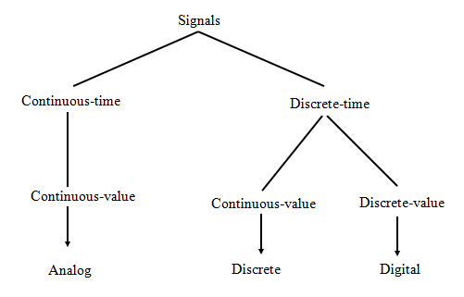
Signal Types
Dr Ngenzi Alexander

Slide 9
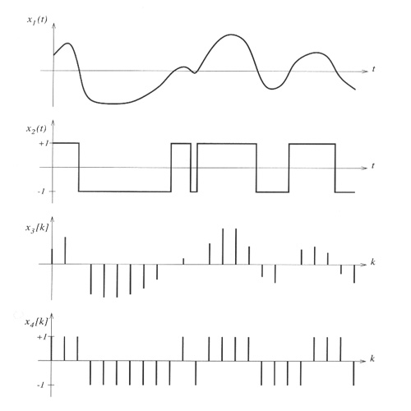
Signal Types representations
Continuous time –
Continuous amplitude
Continuous time –
Discrete amplitude
Discrete time –
Continuous amplitude
Discrete time –
Discrete amplitude
Dr Ngenzi Alexander

Slide 10
Why signal processing?
Why signals? Signals carry information.
Why processing? To obtain signals in a more desirable form, a clean form.
Signals are corrupted by noise, they need to be filtered.
Signal processing can be:
Analog, Digital or Mixed
Dr Ngenzi Alexander

Slide 11
Reason for processing
The specific reason for processing a digital signal may be, for example, to remove interference or noise from the signal, to obtain the spectrum of the data, or to transform the signal into a more suitable form.
Dr Ngenzi Alexander

Slide 12
Digital Signal Processing
Digital Signal Processing uses unique type of data i.e. signal, for processing signals. It refers to the science of analyzing time-varying physical process.
A signal refers to any continuous function of one or more variables such as time, space, frequency, etc. e.g.
  Voltage across a resistor
  Velocity of a vehicle
  Light intensity of an image
  Temperature or pressure inside a system
Dr Ngenzi Alexander

Slide 13
Signal Processing
There are two categories of signal processing:
1. Analog Signal Processing
  Used to describe a waveform that is continuous in time and can take a continuous range of amplitude values. It will be more correct to say continuous signal processing.
  2. Digital Signal Processing
  Used to describe a discrete-time-signal, not a continuous waveform but discrete-time signal quantities with one amplitude value of signal at discrete instants in time.
Dr Ngenzi Alexander

Slide 14
First Signal Processing Problem
World War II brought us Radio Detection And
Ranging (RADAR)
One of the first signal processing applications
It was implemented in analog
Encounter lots of problem, aging, stability, sensitivity…
Dr Ngenzi Alexander

Slide 15
Information Representation Using Analog Signals
Information can be represented using analog signals
Analog signals cannot be manipulated easily
Analog signals must be digitized for computer processing i.e. changed in binary form for computer processing
Dr Ngenzi Alexander

Slide 16
Digital Signal Processing
Advantages
Limitations
Upgradability & Flexibility
Stability & Repeatability
Higher performance and lower cost
Great flexibility of its programmability
        Perfect Reproducibility
        Special Applications
Saving of bandwidth
Bandwidth limitations so limited speed of operation of AD converters and digital signal processors
System complexity: usage of ADC or DAC
DSP systems more expensive
More power
consumption more components
High noise immunity&
& high accuracy
Dr Ngenzi Alexander
Notes:
DISP-2003
Introduction to Digital Signal Processing

Slide 17
Advantages of DSP over ASP (Analog Signal Processing)
Noise-resistance and high accuracy
Great flexibility: DSP operations can be changed by changing the program in digital programmable system.
Stability and repeatability: easily duplicated and independent of temperature, aging and other external parameters.
Simplicity: easy to build any digital system
Easy upgradations: because of use of software
Dr Ngenzi Alexander

Slide 18
6. Compatibility: all applications need standard hardware. Thus operations of DSP system are mainly dependent on software.
Remote processing: Easy information storage on magnetic media without loss of quality of reproduction of signal and easily transported, digital signals can be processed off line.
In some cases, cheaper, digital hardware cheaper and digital circuits can be reproduced easily in large quantities or by time-sharing of given processor among a number of signals.
Dr Ngenzi Alexander

Slide 19
DSP Applications
Have replaced analog circuitry in TV sets and telephones & commonplace in such devices as mobile phones, multimedia computers, video recorders, CD players, hard disc drive controllers and modems.
Dr Ngenzi Alexander

Slide 20
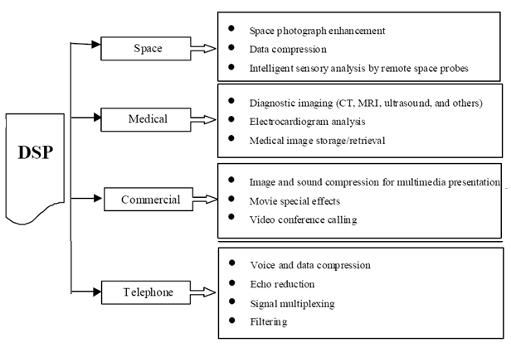
Dr Ngenzi Alexander

Slide 21
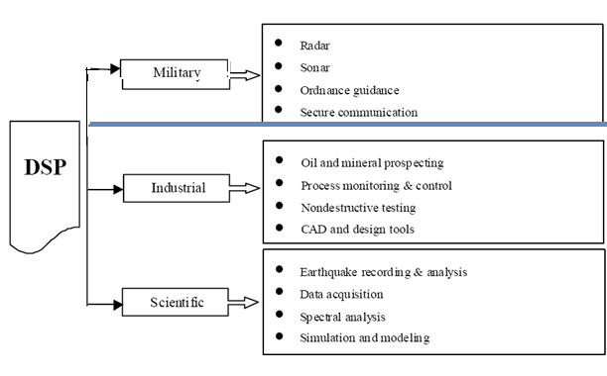
Dr Ngenzi Alexander

Slide 22
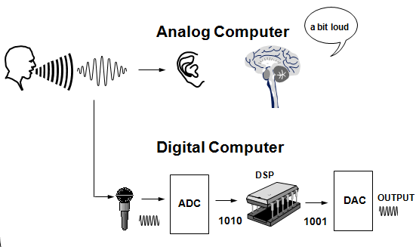
What Is DSP?
Dr Ngenzi Alexander

Slide 23
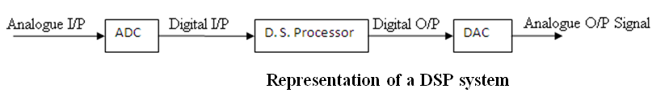
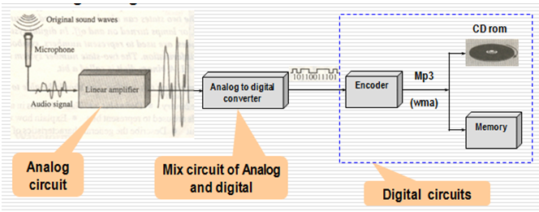
Examples of DSP System
Dr Ngenzi Alexander

Slide 24
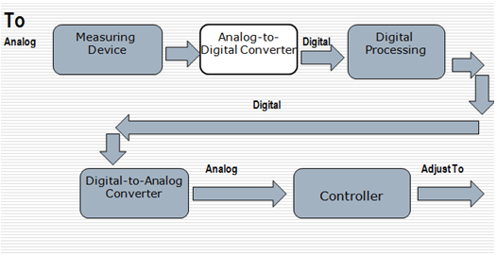
Temperature Control System
Dr Ngenzi Alexander

Slide 25
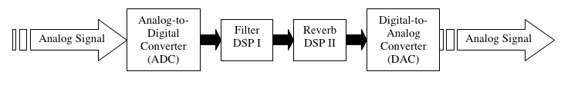
DSP System Overview
Receives a signal, processes it, and outputs result
Several DSPs can be linked together in a serial chain
Can be implemented in software or hardware
Dr Ngenzi Alexander

Slide 26
Key DSP Operations
  Convolution
  Correlation (Cross & Auto)
  Filtering
  Discrete transform
Dr Ngenzi Alexander

Slide 27
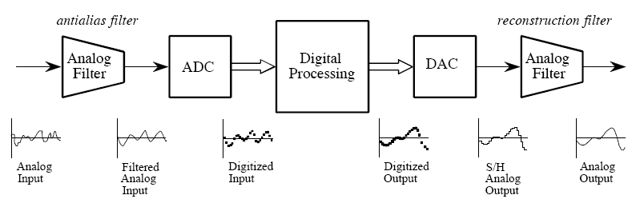
Basic Elements of DSP
Dr Ngenzi Alexander

Slide 28
Function of basic elements of DSP
Analog I/P Signal generated from some transducer or from some communication system or biomedical signal like ECG Electrocardiogram (heart signals) or EEG Electroencephalogram(brain signals).
Low pass filter (Antialiasing filter) removes the high frequency noise contain in input signal.
Analog to digital converter (ADC): used to convert analog signal into digital form, because digital signal processor accepts the signal which is digital.
Dr Ngenzi Alexander

Slide 29
Digital Signal Processor : It processes input signal digitally. It can be a digital computer or a microprocessor programmed to perform the desired operations on the input signal or also a hardwired digital processor.
Digital to analog converter (DAC): the output of digital signal processor is digital in nature. But the required final output is analog in nature. So to convert digital signal into analog signal.
Output Filter signal is analog that means it is continuous signal. But it may contain high frequency components. Such high frequency components are unwanted. To remove these components output filter is used.
Dr Ngenzi Alexander

Slide 30
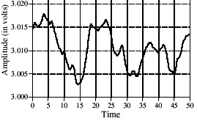
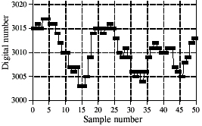
Analog to Digital Conversion
Converts a continuous, analog signal into a discrete, digital signal
Analog signal is sampled at a regular interval
Sampled values are stored as a data stream
Dr Ngenzi Alexander

Slide 31
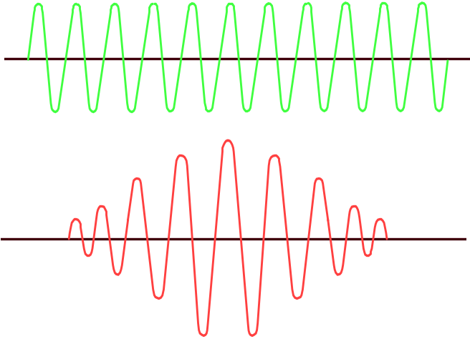
Analog to Digital Conversion
1 0 1 1 0 1 0 0
A to D Converters, Digital Signal Processors (DSP)
Dr Ngenzi Alexander

Slide 32
Data Transmission Using Analog Technology
Modem
Computer
Digital: 0s and 1s
Analog
Digital-to-Analog Modulation
Modem from mo ( dulator ) dem ( odulator )] is an electronic device that makes possible the transmission of data to or from a computer via telephone or other communication lines.
Dr Ngenzi Alexander

Slide 33
Digital Information Processing
Data
Digitized and Encoded
Digital
Transmission
Audio
Image
Video
Dr Ngenzi Alexander

Slide 34
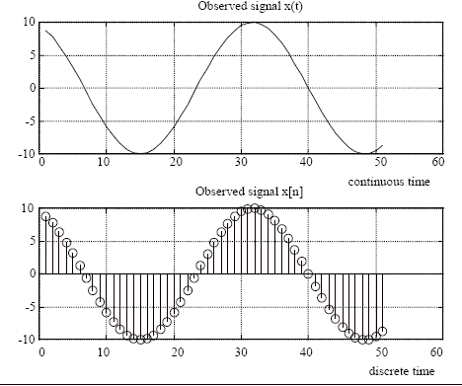
From Continuous to Discrete: Sampling
Dr Ngenzi Alexander

Slide 35
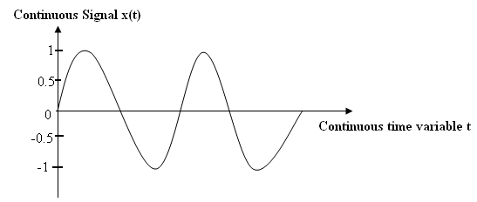
Sampling theorem
where : x(t)= sinωt or x(t)= sin2πf_{o}t;
f_{o}, Frequency in Hz and t time in seconds
If the highest frequency component in a signal is f_{max}, then the signal should be sampled at the rate of at least 2 f_{max .} Ex. If f_{max} is 4kHz, then to preserve or capture all the information in the signal, sample it at 8Khz or more
Dr Ngenzi Alexander

Slide 36
Sampling Theorem
Nyquist - Shannon sampling theorem honors Harry Nyquist and Claude Shannon
  A signal must be sampled at a rate at least 2x the frequency of the maximum frequency component (Nyquist frequency) or else aliasing will occur [Nyquist (1928), Shannon (1949)] Harry Nyquist was an important contributor to communication theory
Aliasing is the inability to accurately reconstruct a signal from sampled data.
Low-pass analog filter (anti-aliasing filter) applied before sampling.
Dr Ngenzi Alexander

Slide 37
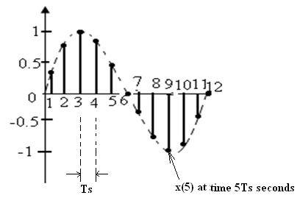

The discrete-time waveform x(nT_{s})
If x(t)= sinωt or x(t)= sin2πf_{o}t; T_{s} : sampling time
period and n: number of samples
Then x(nT_{s})= sin2πf_{o} nT_{s}
F_{s} is the sampling frequency = 1/T_{s}
x(nT_{s}) is a representation of x(t) that is sampled once every T_{s} seconds using an ADC.
Dr Ngenzi Alexander

Slide 38
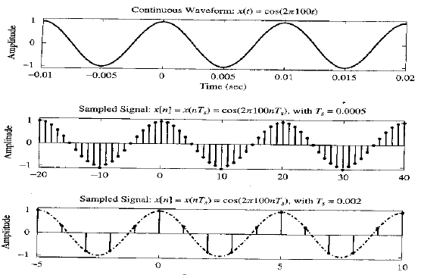
Sampling
Dr Ngenzi Alexander

Slide 39
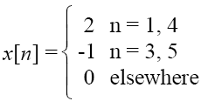


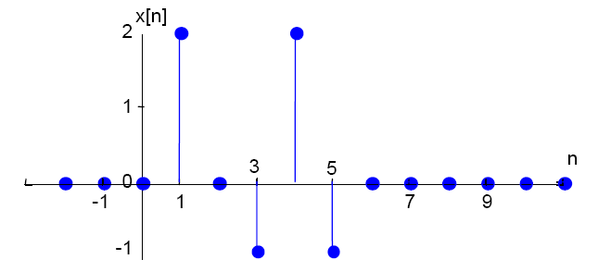
Discrete-time signal representation
1.Functional representation:
2.Sequence representation:
3. Tabular representation
4.Graphic representation:
Dr Ngenzi Alexander

Slide 40
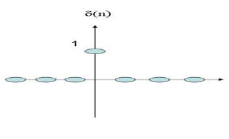
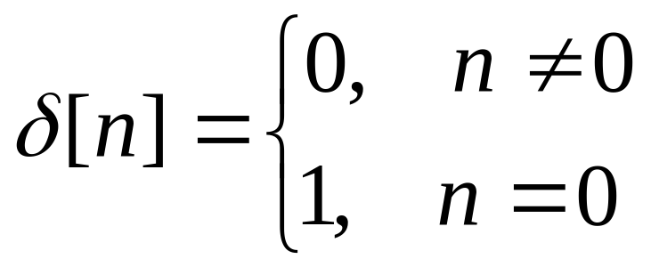

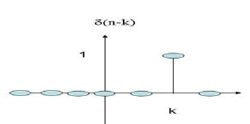
Unit impulse (or unit sample):
Common Discrete Time Signals
Impulse Signal
Delayed unit sample or
shifted unit impulse
Dr Ngenzi Alexander

Slide 41
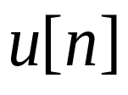
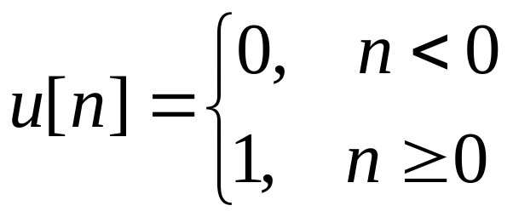
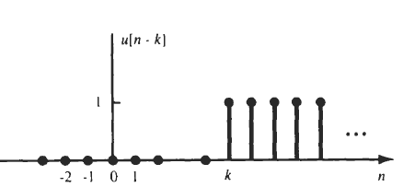

Common Discrete Time Signals
Unit Step Signal
Unit step sequence
1
n
0
Delayed or shifted unit step sequence.
Dr Ngenzi Alexander

Slide 42
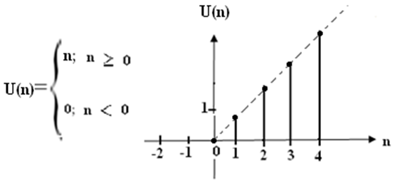
Common Discrete Time Signals
Ramp Signal
Dr Ngenzi Alexander

Slide 43
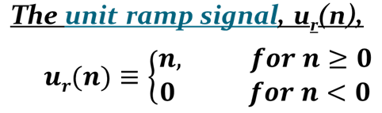
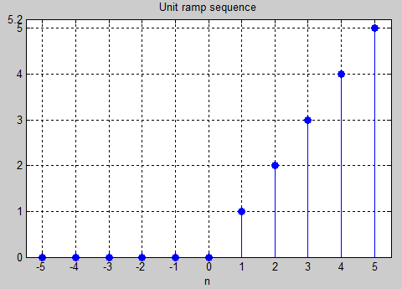
Common Discrete Time Signals
Dr Ngenzi Alexander

Slide 44
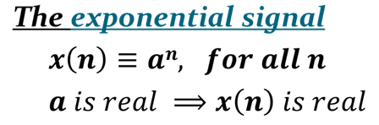
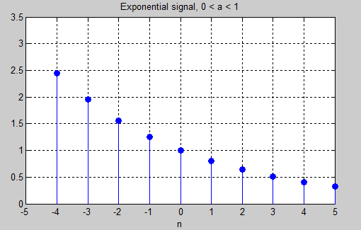
Common Discrete Time Signals
Dr Ngenzi Alexander

Slide 45
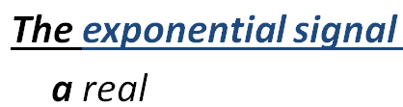
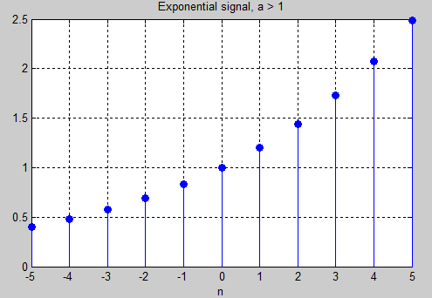
Common Discrete Time Signals
Dr Ngenzi Alexander

Slide 46
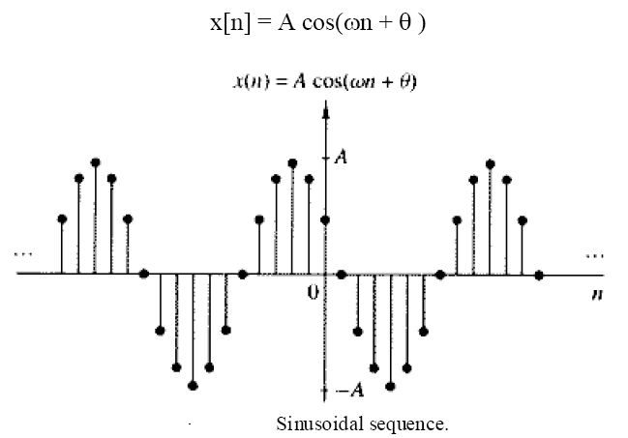
Sinusoidal Sequence
Period is 2π/ω only when 2π/ω is an integer.
Dr Ngenzi Alexander

Slide 47
Discrete Time (DT) Signal Expression
x(n) be a discrete time signal
δ(n-k) be a delayed impulse signal
If we multiply x(n) with the delayed impulse δ(n-k),
then the product is non-zero only at n = k and zero for all other values of n. Also, at n = k, the value of the product signal is the k^{th} sample of signal x(k).
x(n) δ(n-k) = x(k)
Dr Ngenzi Alexander

Slide 48
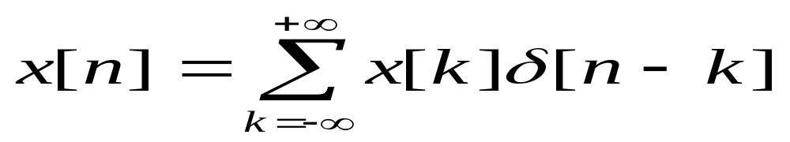
DT Signal Expression
Each multiplication of x(n) with δ(n-k) at same delay k picks out the signal value x(k) of the signal x(n) at n=k. If we repeat this from
-∞ < k < ∞, and sum all the product sequences, the result will be a sequence of that is equal to x(n).
Any discrete-time signal can be expressed as a summation of impulses.
Dr Ngenzi Alexander

Slide 49
Example
x(n) δ((n-(-3)) = x(-3)
x(n) δ((n-(-2)) = x(-2)
x(n) δ(n-(-1)) = x(-1)
x(n) δ(n) = x(0)
x(n) δ(n-1) = x(1)
x(n) δ(n-2) = x(2)
x(n) δ(n-3) = x(3)
x(-3) = x(-3) δ((n-(-3))
x(-2) = x(-2) δ((n-(-2))
x(-1) =x(-1) δ((n-(-1))
x(0) = x(0) δ((0)
x(1) = x(1) δ((n-1))
x(2) = x(2) δ((n-2
Thus we can say that x(n) is the product of the samples and the delayed impulses:
x(n)= …… + x(-3)+ x(-2)+ x(-1)+ x(0)+ x(1)+ x(2)+ … +x(…)+…..
= ….. x(-3) δ((n-(-3))+ x(-2) δ((n-(-2))+ x(-1) δ((n-(-1))+ x(0) δ((0)+ x(1) δ((n-1))+ x(2) δ((n-2)+ ……
Dr Ngenzi Alexander

Slide 50
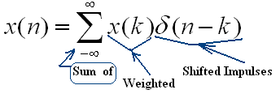
Sum of Weighted Shifted Impulses
:
Any sequence, x[n], can be expressed as a sum of scaled, delayed impulses
Dr Ngenzi Alexander

Slide 51
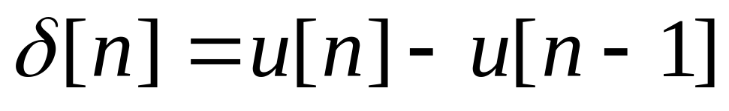
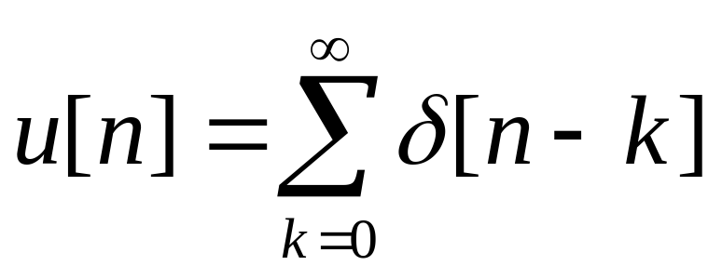
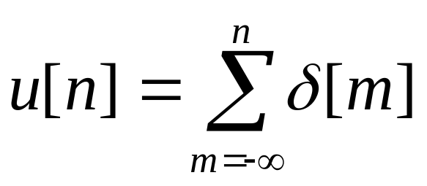
Relationship between impulse
and
unit step signal
The impulse signal is the first difference of the unit step signal
The unit step signal is the running sum of the impulse signal
Dr Ngenzi Alexander

Slide 52
Manipulations of Discrete Time Signal
Shift in time : x[n] it is the operation that gives us either delayed version x [n-2]or an advanced version x [n +2]
Folding or reflection : from x[n] it is the operation that gives us the signal x[−n], replace n by -n of x(n) about n = 0
Addition, multiplication and scaling of sequences :
Amplitude scaling: y [n] = A x [n]
Sum of 2 signals : y [n] = x₁ [n] + x₂ [n]
Product of 2 signals: y [n] = x₁ [n] . x₂ [n]
Dr Ngenzi Alexander

Slide 53
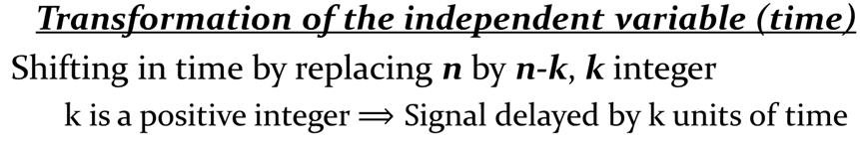
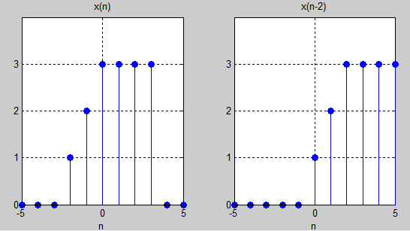
Manipulations of Discrete Time Signal
Dr Ngenzi Alexander

Slide 54
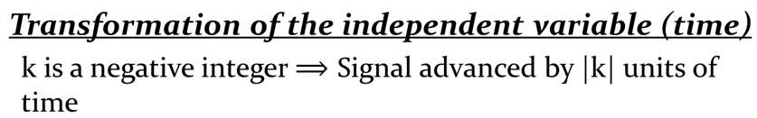
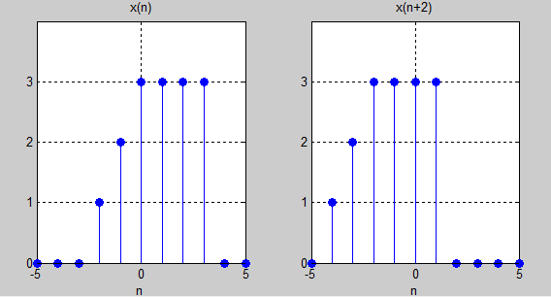
Manipulations of Discrete Time Signal
Dr Ngenzi Alexander

Slide 55
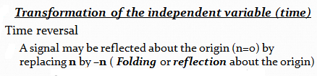
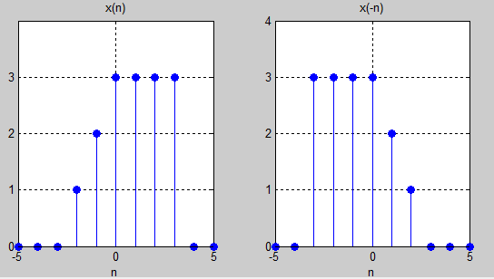
Manipulations of Discrete Time Signal
Dr Ngenzi Alexander

Slide 56
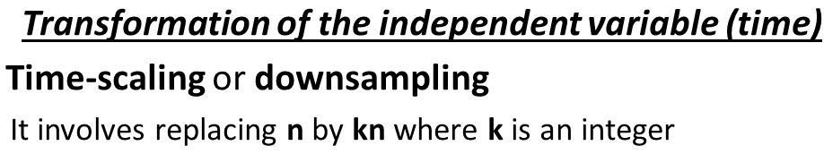
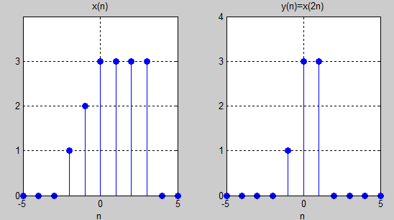
Manipulations of Discrete Time Signal
Dr Ngenzi Alexander

Slide 57
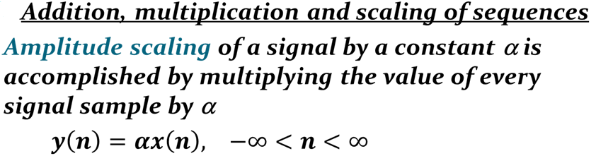
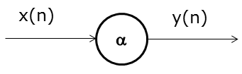
Manipulations of Discrete Time Signal
Dr Ngenzi Alexander

Slide 58
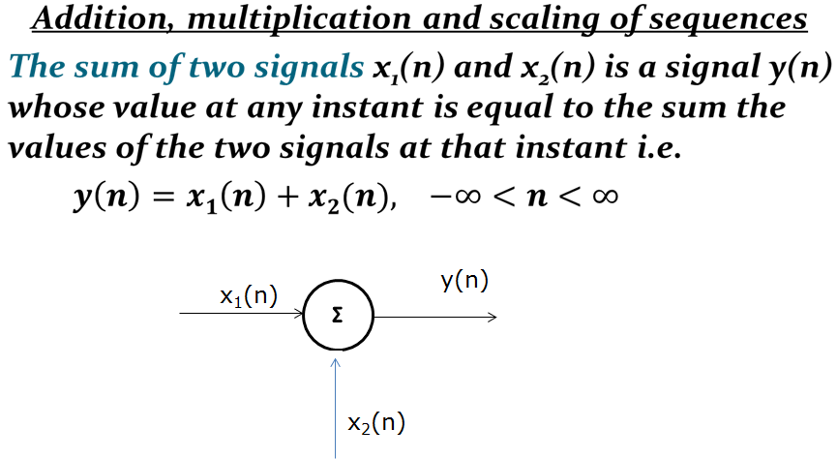
Manipulations of Discrete Time Signal
Dr Ngenzi Alexander

Slide 59
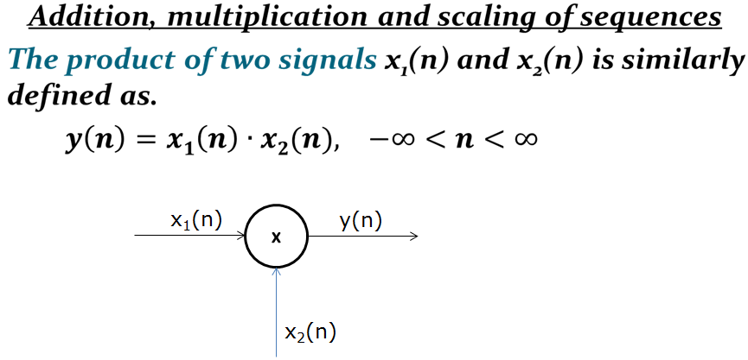
Manipulations of Discrete Time Signal
Dr Ngenzi Alexander

Slide 60


Classification of Signals
Energy & Power Signals
For a discrete-time signal x[n]
Normalized energy content E of x[n]
Normalized average power P of x[n]
Dr Ngenzi Alexander

Slide 61
Classification of Signals
Energy & Power Signals
A signal x[n] is said to be an energy signal if and only if , and so .
2. A signal x[n] is said to be a power signal if and only if , and so
3. Signals that satisfy neither property are referred as neither energy signals nor power signals
Dr Ngenzi Alexander

Slide 62

Classification of Signals
Periodic vs. Aperiodic Signal
A discrete-time signal x[n] is said periodic if
x[n] = x[n + N] for all values of n, x[n]) is
periodic with period N because it repeats itself
after a fixed period N, otherwise it is called
aperiodic or non periodic.
Dr Ngenzi Alexander

Slide 63


Classification of Signals
Dr Ngenzi Alexander

Slide 64


Classification of Signals
Dr Ngenzi Alexander

Slide 65


Continuous-Time System
x(t) → y(t)
Dr Ngenzi Alexander

Slide 66


Discrete-Time System
x[n] → y[n]
Dr Ngenzi Alexander

Slide 67

Continuous-Time &Discrete-Time Systems
A system operates on a signal (the input) to modify, transform or re-express it in another form (the output) which may be more desirable.
Example of system: The input voltage E(t) produces an output voltage Vo(t) .
Continuous-time input signals are applied and result in continuous-time output signals.
Discrete-time input signals are applied and result in discrete time output signals.
Dr Ngenzi Alexander

Slide 68
Discrete-Time Systems
A system is a physical device that performs an operation on the signal.
Example: A filter used to reduce noise in the information bearing signal is called a system.
In contexts from signal processing to communications, a system: a process in which input signals are transformed by the system or cause the system to respond in some way, resulting in outputs signals.
Discrete-time system:
x[n] → y[n]
Dr Ngenzi Alexander

Slide 69
Classification of Systems
Systems may be classified into:
Time-invariant and time-variant systems
Linear and non-linear systems
Causal and non-causal systems
Dr Ngenzi Alexander

Slide 70

Time-invariant and Time-Variant System
A system is called time- or shift-invariant if a time shift (delay or advance) in the input signal causes the same time shift in the output signal.
A system that is not time-invariant is time varying.
Example: y[n] = x[M n], - ∞ < n < ∞
By considering the response y₁[n] to the input x₁[n] defined as x₁[n] = x[n - n₀]:
y₁[n] = x₁[M n] = x[M n - n₀]
But y[n - n₀] = x[M (n - n0)] ≠ y₁[n] unless of course M = 1.
Dr Ngenzi Alexander

Slide 71

Linear Systems
A linear system exhibits the additivity property:
It also must satisfy the homogeneity or scaling property:
These can be combined into the property of superposition:
Dr Ngenzi Alexander

Slide 72
Non-linear system
A non-linear system is one that is NOT linear (i.e. does not obey the principle of superposition). At least one of the above properties (additivity or scaling) does not hold
Examples of non-linear systems:
y = x²
T[x₁ + x₂ ]= (x₁ + x₂)² = x₁² + x₂² + 2 x₁x₂
≠ T[ x₁] + T [ x₂ ] = x₁² + x₂²
Dr Ngenzi Alexander

Slide 73
Linear Time-Invariant Systems
If the system is linear and also time
Invariant or shift invariant, then it is
called a linear time invariant(LTI)or
a linear shift invariant (LSI) system.
Dr Ngenzi Alexander

Slide 74


Causal and Non causal Systems
A system is causal if the output at any time depends only the present and/or past values of the input, not on its future values
example:
A system is called non causal if it depends on its future values
Examples of non causal systems are
Dr Ngenzi Alexander

Slide 75
INDICATIVE RESOURCES
1. John G Proakis, Dimtris G Manolakis, “Digital Signal Processing Principles, Algorithms and Application”, PHI, 4th Edition, 2006,
2. Emmanuel C. Ifeacher, Barrie W. Jervis, “Digital Signal Processing A Practical Approach, 1993
3. B Venkataramani & M Bhaskar, Digital Signal Processors Architecture, Programming and Applications, 2nd Edition, 2011, 004.16 VEN 2011.
4. M.H.Hayes, “Digital Signal Processing”, Schaum’s Outlines, McGraw-Hill, 1999.
Dr Ngenzi Alexander

